Slide 1
Electric Vehicle Population Dataset Analysis Source: Kaggle Dataset: Electric vehicle Population Dataset
Name: P. Himabindhu
Roll No: 2211CS010424
Section: S1-63

Slide 2
Introduction
The Electric Vehicle (EV) Population Analysis Project aims to explore and understand the adoption and distribution of electric vehicles across different regions. With the growing emphasis on sustainable transportation and reducing carbon emissions, analyzing EV registrations provides insights into consumer behavior, market trends, and regional adoption patterns.
This project focuses on examining a dataset containing information about electric vehicles registered in the United States, including details such as vehicle make, model, year, type (Battery Electric Vehicle or Plug-in Hybrid), and geographic location (city, county, state).

Slide 3
Initial Analysis of the Dataset
1. Dataset Overview:
Total Records: The dataset contains [insert total rows] records of registered electric vehicles.
Columns / Features: 10–12 columns including VIN, Vehicle Make, Model, Year, EV Type, City, County, State, and Postal Code.
Data Types:
Categorical: Vehicle Make, Vehicle Model, EV Type, City, County, State
Numerical: Vehicle Year
Identifier: VIN
2. Missing Values:
Some fields like Postal Code and City had missing values.
EV Type and Vehicle Year were mostly complete.
Missing data was either removed or filled with appropriate placeholders during cleaning.

Slide 4
Initial Analysis of the Dataset
3. Duplicate Records:
Duplicate entries were found based on VIN, which were removed to ensure data integrity.
4. Unique Values and Distribution:
Vehicle Makes: Tesla, Nissan, Chevrolet, Ford, etc. Tesla was the most frequent.
Vehicle Models: Model 3, Model Y, Leaf, Bolt, etc.
EV Types: Majority were Battery Electric Vehicles (BEV), followed by Plug-in Hybrid Electric Vehicles (PHEV).
Geography: Highest EV registrations were in urban areas like King County, followed by Pierce and Snohomish counties.
5. Summary Statistics (Numerical Columns):
Vehicle Year:
Oldest EVs: ~2011
Newest EVs: 2025
Majority of vehicles registered after 2018, indicating increasing adoption.

Slide 5
Initial Analysis of the Dataset
6. Initial Observations:
Urban areas have higher EV penetration.
Tesla dominates the EV market in the dataset.
Newer vehicles are more likely to be BEVs.
There is a clear upward trend in EV registrations over the years.
7. Next Steps:
Perform descriptive analytics to visualize distributions and trends.
Conduct relationship analysis to see how vehicle type, year, and region are correlated.
Identify key insights for market trends, geographic adoption, and manufacturer popularity.

Slide 6
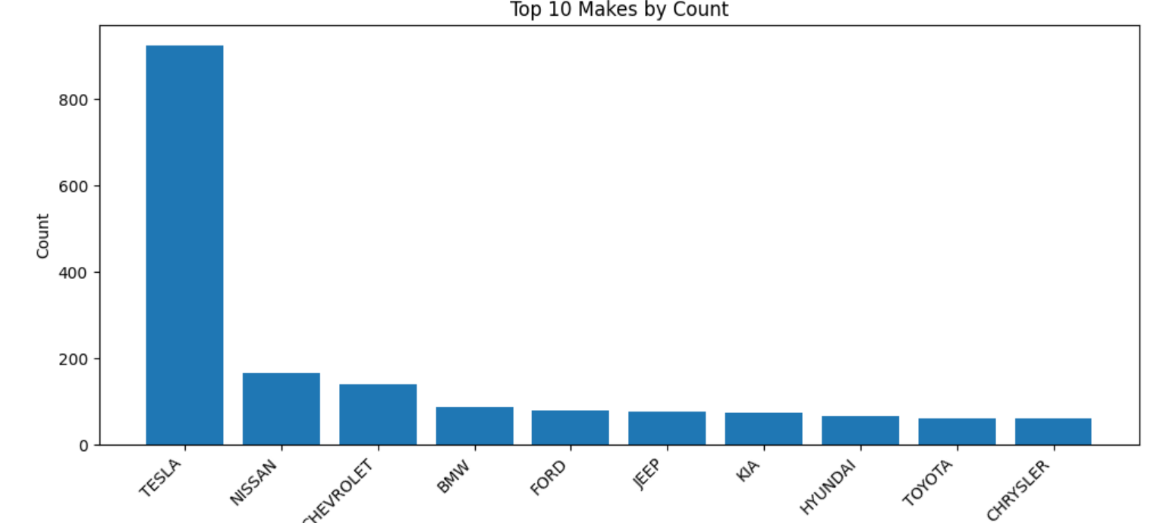
Visual Insights from Initial Analysis
The chart shows the top 10 car makes by count. Tesla is way ahead with the highest count, followed by Nissan and Chevrolet. The other makes like BMW, Ford, Jeep, Kia, Hyundai, Toyota, and Chrysler have relatively lower counts.

Slide 7
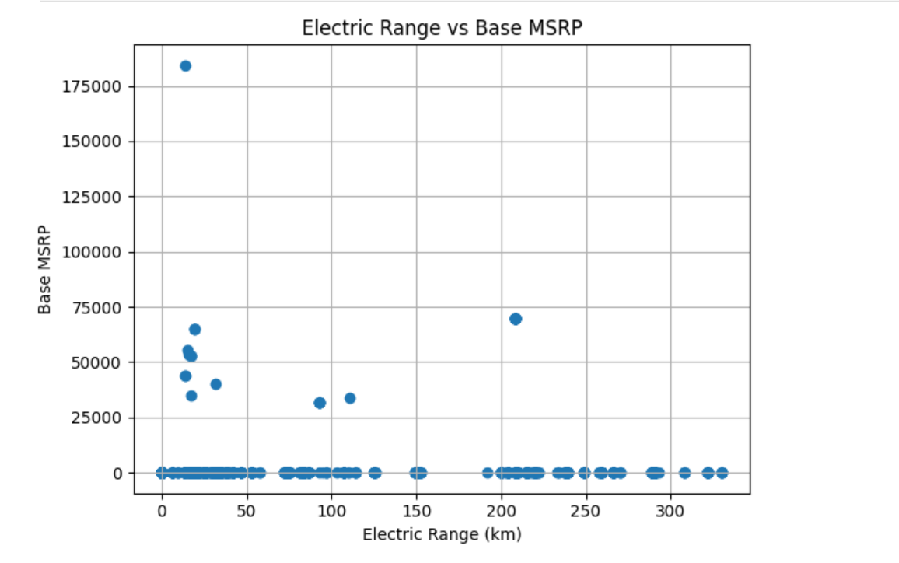
Visual Insights from Initial Analysis
The plot suggests that most vehicles have a Base MSRP of 0 (possibly indicating non-priced or placeholder data), and there's no strong correlation visible between Electric Range and Base MSRP for the non-zero MSRP data points.

Slide 8
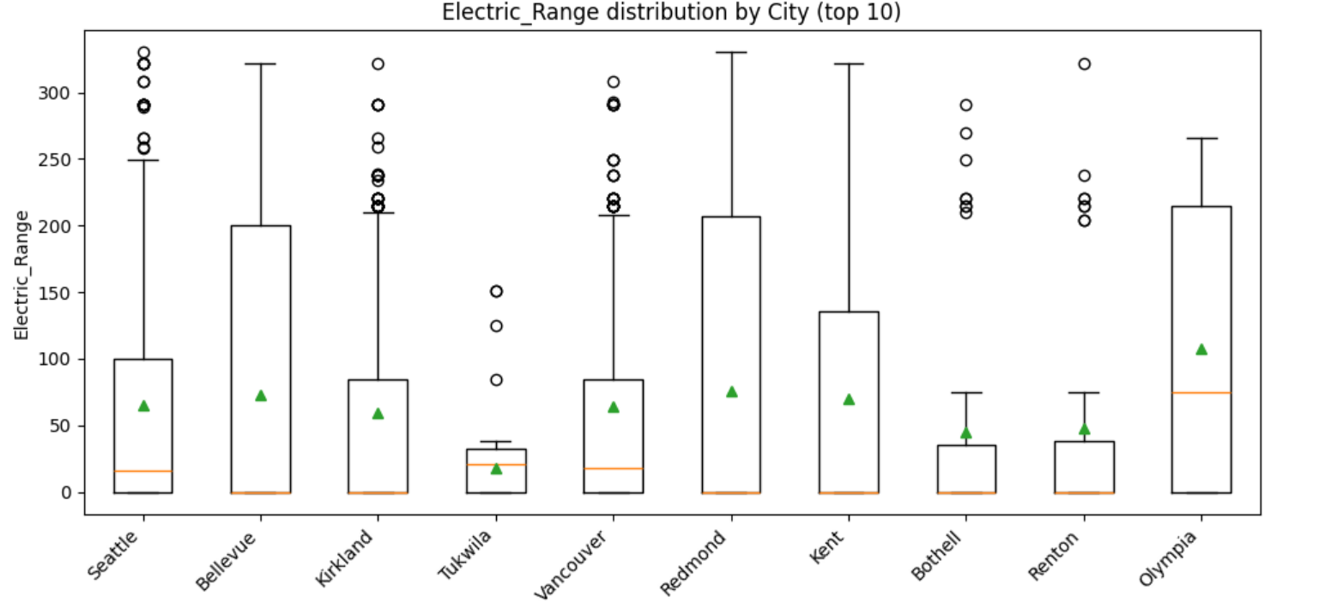
Visual Insights from Initial Analysis
Top makers with higher ranges: Tesla, Chevrolet
Lower ranges: Ford, Jeep, Kia, Hyundai, Toyota, Chrysler
Outliers: Present in Hyundai, others like Tesla have wide range variability

Slide 9
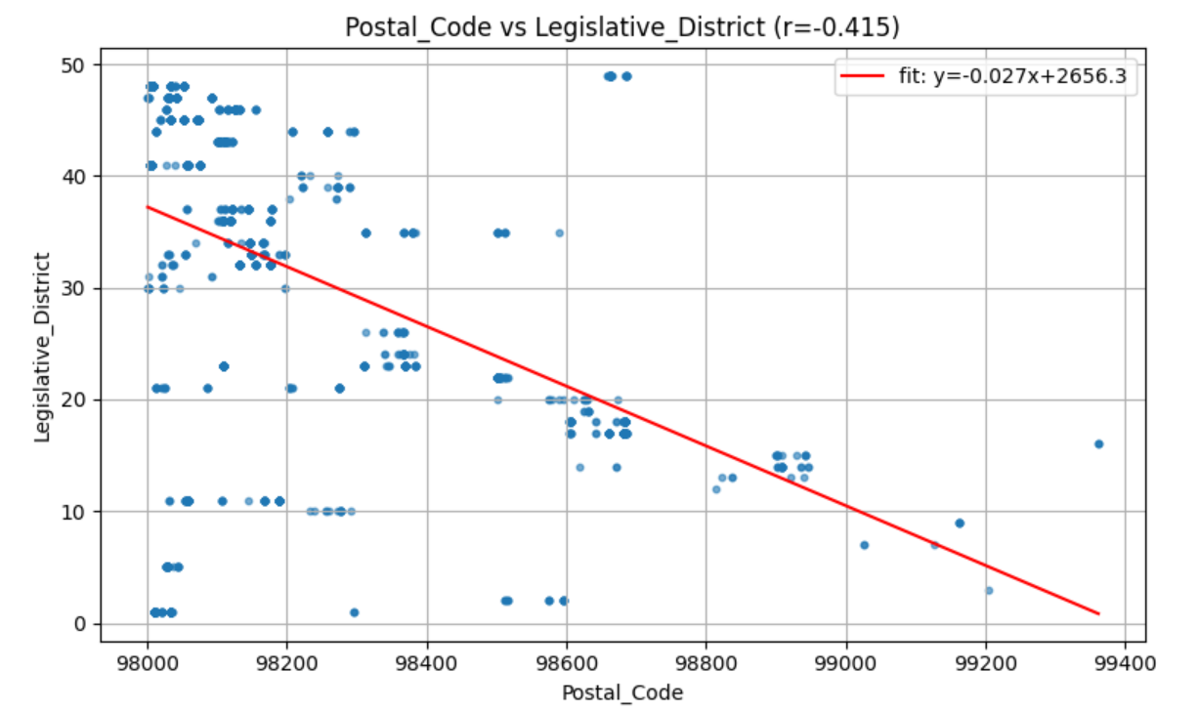
Visual Insights from Initial Analysis
Postal Code vs Legislative District plot shows a negative correlation (r = -0.415). As Postal Code increases, Legislative District tends to decrease. The fit line is
y = -0.027x + 2656.3.

Slide 10
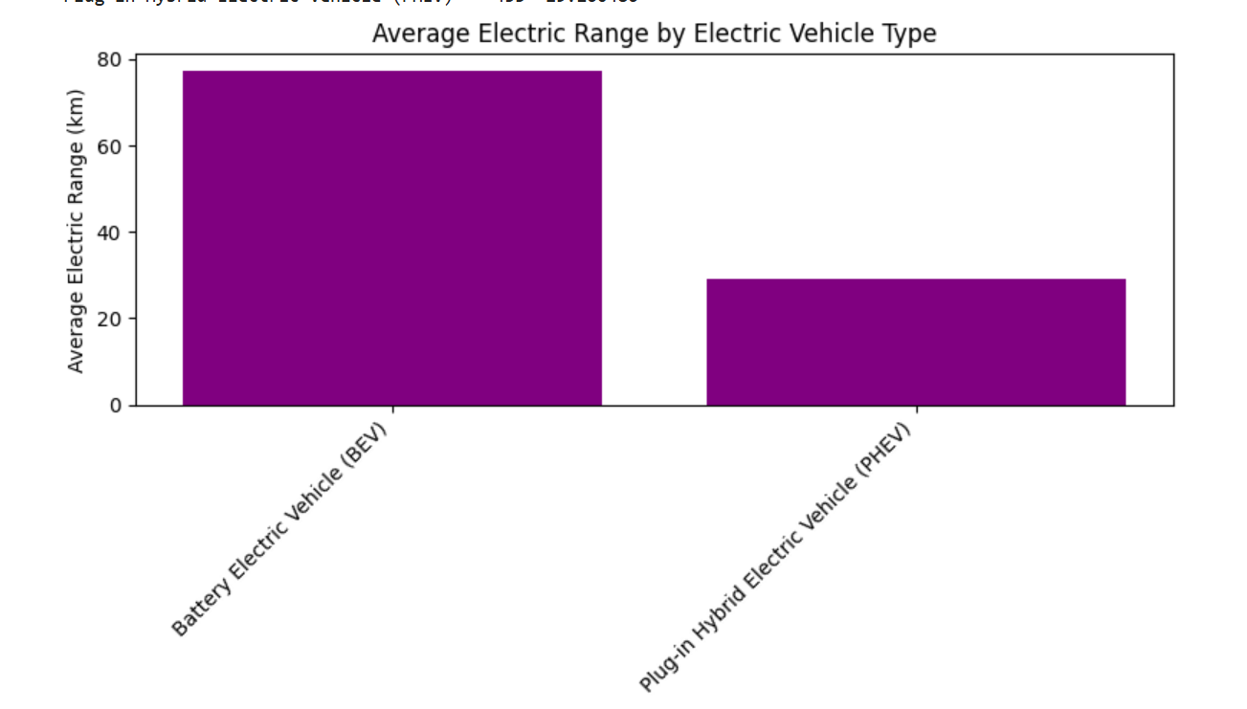
Visual Insights from Initial Analysis
The image shows a bar chart comparing the average electric range of Battery Electric Vehicles (BEVs) and Plug-in Hybrid Electric Vehicles (PHEVs). BEVs have a higher average electric range of about 75 km. PHEVs have an average electric range of around 30 km.

Slide 11
Dataset Observations
Geographical Distribution
Certain states and counties have a significantly higher number of electric vehicles (EVs), indicating early adoption trends and better infrastructure.
Major urban areas and tech hubs show the highest EV registrations.
2. City-Level Insights
Cities with higher income levels or strong environmental policies tend to have more EVs registered.
Smaller towns or rural areas show minimal adoption.
3. Trends by Vehicle Type
Specific EV models dominate registrations, reflecting market popularity and consumer preferences.
Newer EV models are increasingly popular compared to older ones, showing a shift in adoption patterns.

Slide 12
Dataset Observations
4. Relationship Between Factors
Positive correlation between city population and number of EVs.
Some counties with strong incentives or subsidies show faster growth in EV adoption.
5. Data Quality & Limitations
Some missing or inconsistent data in city and VIN fields, which may affect detailed analysis.
Need for more granular temporal data to analyze adoption over time.
6. Overall Insight
The EV population is concentrated in urban, high-income, and policy-supported regions, showing early adoption patterns.
Potential for growth in underrepresented areas with proper incentives and infrastructure.

Slide 13
Conclusion
The analysis of the Electric Vehicle (EV) Population dataset reveals that EV adoption is primarily concentrated in urban, high-income, and policy-supported regions. Major cities and counties show higher registrations, while rural areas and smaller towns lag behind. Popular EV models dominate the market, and newer vehicles are seeing increasing adoption. Correlation analysis indicates that population density and supportive local policies significantly influence EV ownership. Overall, the dataset highlights early adoption patterns, identifies areas with growth potential, and underscores the importance of infrastructure and incentives in accelerating EV adoption.

